Slide 1
RecipeTop: Group 7
Critical Design Review
Gera Versfeld, EE Miguel Ramirez, CpE
Edwin Santiago, EE Jason Portillo, CpE

Slide 2
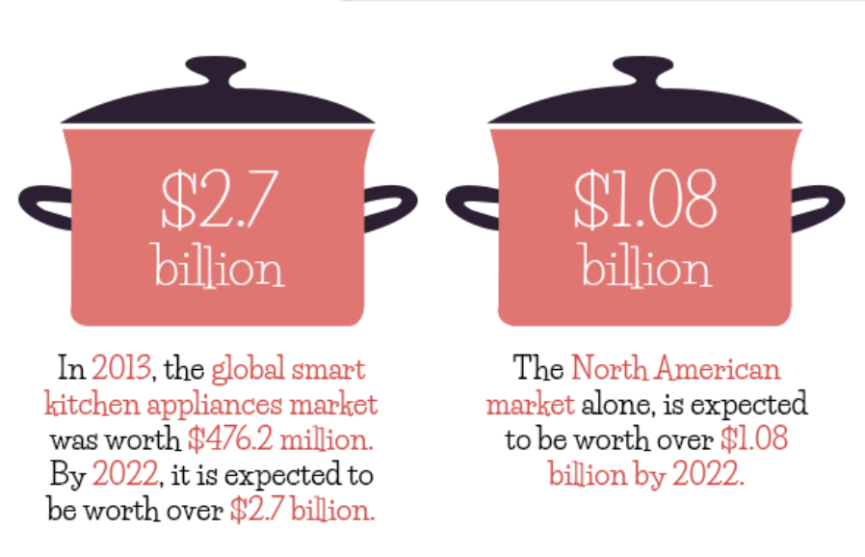
Motivation
Create something that helps people learn to cook
Make cooking a more organized and enjoyable experience
Make the kitchen a more fully integrated part of a modern smart home
Notes:
Miguel
Edwin - Story
How many people here cook using their phones to look up recipes online? Cooking using online recipes is great because it gives you measurements of the ingredients needed and the step-by-step to complete a delicious meal. But let me give you a scenario. Say you were baking a cake, in the preparation stages, you would probably get your hands full of flour. Now if I want to see what the next step of my recipe is, I need to touch my phones display and smear it with flour and that is what I don’t like about following a recipe with my phone. So we wanted to develop a device that could show us our next step and be cleaned as easily as a countertop.
Miguel-Although we wanted to create something that was going to help someone complete a certain task, we also wanted our project to be practical. As you can see in the graphic , the smart kitchen appliance market is expected to be worth over 2.7 billion dollars in a couple of years.

Slide 3
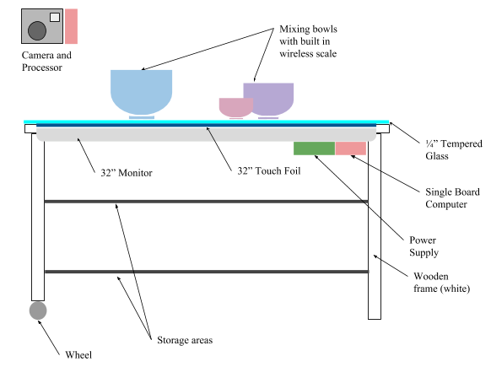

What is RecipeTop?
An interactive countertop and recipe preparation assistant
Notes:
Jason
RecipeTop is an interactive countertop and recipe preparation assistant. It will have a touch screen display surface to allow user to interface with a recipe management application. The application will allow users to browse, create, and execute recipes. Additionally, we will have an integrated wireless scale to enable the users to weigh ingredients for their recipes.

Slide 4
Objectives
Core
Advanced
Stretch
A multi-touch countertop that will provide users with a unique and helpful experience when cooking.
Seamlessly interface with other kitchen appliances to make cooking simpler.
We hope to integrate computer vision and ML to for more interactivity and better recipe suggestions.
Multi-touch enabled display
Intuitive user interface
Recipe search, storage, and suggestions
Recipe guidance with clear steps and useful features like automatic timers
Companion mobile application
Recipe search and suggestion based on ingredients on counter
Integration with smart home products like Alexa or Google Assistant
Wirelessly connected scale
Wirelessly connected and controlled toaster oven
Compact design with storage space built in
Notes:
Gera

Slide 5
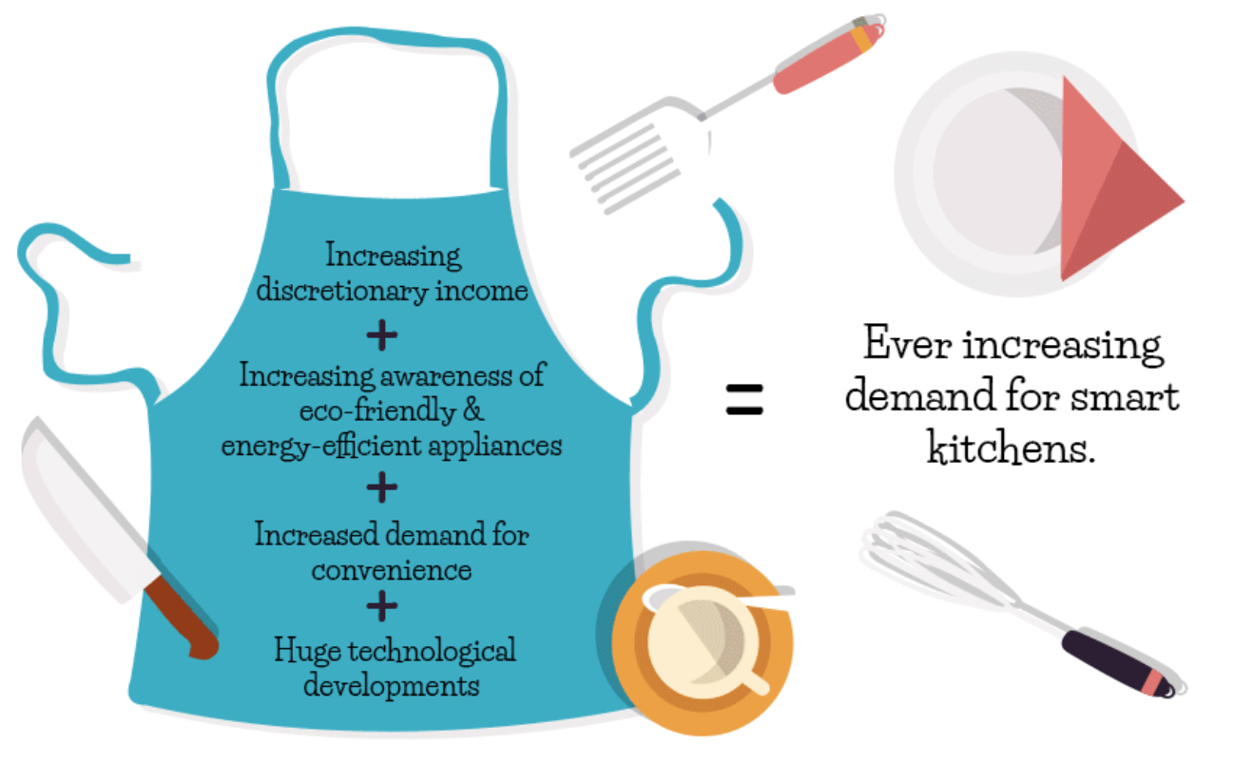
Marketing Goals
Letter | Marketing Goal
a | Low cost
b | User Friendly
c | Durable, Kitchen Safe
d | Food safe
e | Help you learn to cook
f | Easy to clean
Notes:
Miguel
Rephrase everything on the chart?
Idk what else to put besides re-reading the stuff we put on the sd1 paper
For the marketing Goals, We wanted to make sure

Slide 6
Engineering Specifications
# | Specification | Quantity | MG
1 | Diagonal Display Size | 30 in | a,b,e
3 | Display Refresh Rate | ≥ 20Hz | b
4 | UI Response Time | ≤ 200ms | b
# | Specification | Quantity | MG
8 | Scale Accuracy | ≤ 1g | b
10 | Counter Height | ≥ 30 in | b,c,f
11 | Countertop Diagonal | ≥ 35in | a,b,c,f
12 | Total Prototype Cost | ≤ $2000 | a
13 | Touchscreen Multi-touch Capability | ≥ 2 touch points | b,e
Notes:
Jason
As you can see in the table, many of our engineering specifications are user focused to provide a great user experience. For example, the UI response time is very important as it will dictate the lagginess and feel of our system. Other important specifications are the scale accuracy and multi-touch capability. The rest of the specifications are there to ensure the system has the proper specs to handle all of the processing.

Slide 7
Design Constraints
Economic and Time Constraints
Overall budget for senior design: $2000
Two semesters to complete project
Environmental, Social, and Political Constraints
Sustainably manufactured components
Proper disposal of electronic waste
Ethical, Health, and Safety Constraints
Smooth, non-porous surface important for safe food handling
non-toxic, durable
appropriate working height
prevent risk of fire or shock, properly insulate and waterproof electronic components
electronics need heat management systems
Notes:
Gera

Slide 8
Relevant Standards
NEMA 250
Provide a degree of protection of the equipment inside the enclosure against ingress of solid foreign objects (falling dirt).
HTML/CSS W3C
CSS Files
Code efficiency
Device compatibility
User accessibility
Will not follow internet search optimization guidelines since application will function locally
NASA TECHNICAL STANDARD: SOLDERED ELECTRICAL CONNECTIONS
Fillet - smooth concave buildup of material between two surfaces
Soldering environment ventilation system shall comply with OSHA requirements, 29CFR
Javascript Standards
Uniform and consistent coding style
Naming convention
Commenting and semicolon use
Notes:
Edwin

Slide 9
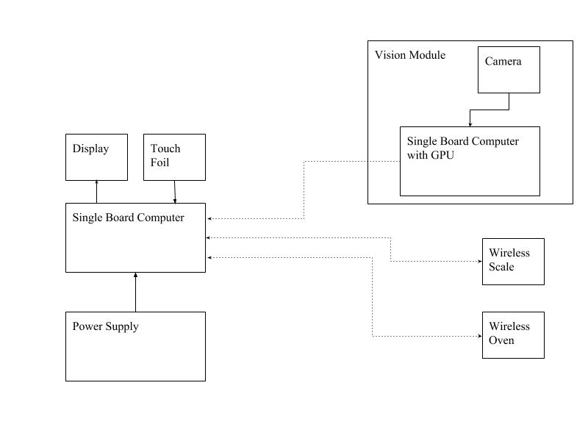
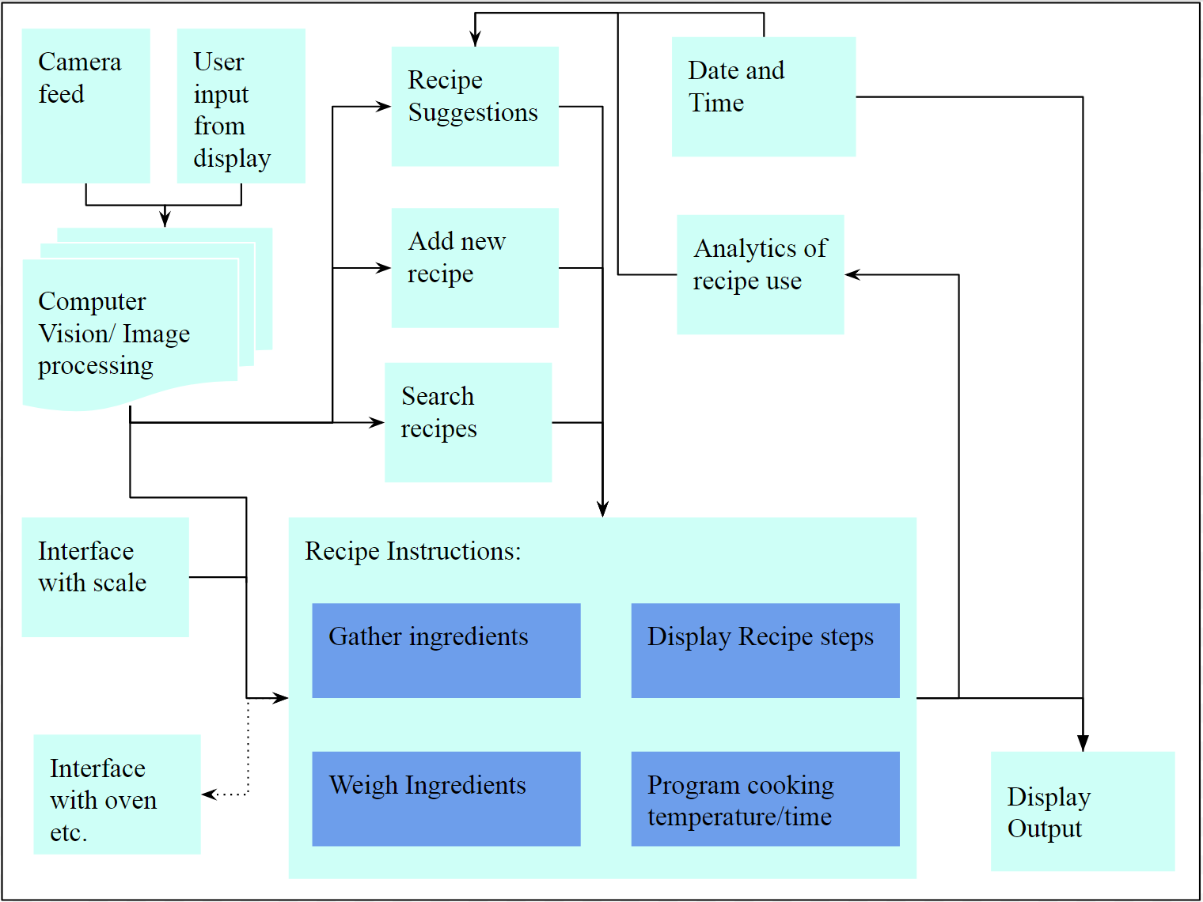
Overall System Block Diagrams
Hardware Software
Notes:
Gera

Slide 10
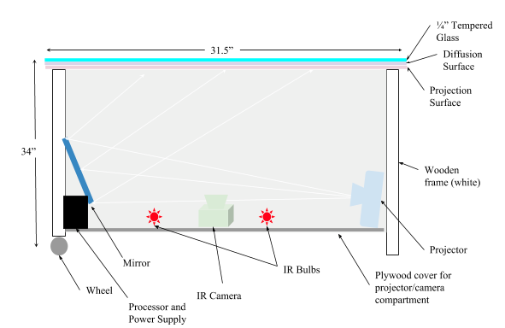
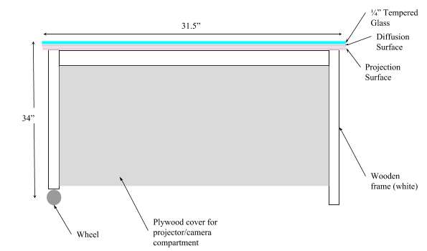
Overall Approach and Proposed Implementation
Notes:
Gera

Slide 11
Significant component and part selections
Single Board Computer
Microcontroller
Wifi Module
Touchfoil
Load Cells
Notes:
Miguel

Slide 12
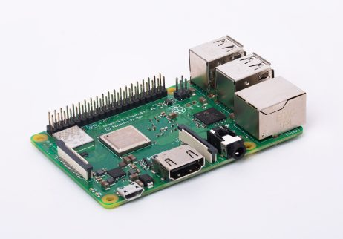
Single Board Computer
 | Beagle Board | Raspberry Pi 3 b+ | Jetson TX2
CPU | ARM37x 1 GHz | Quad core 1.4Ghz | L2+ Quad ARM
GPU | Power VR SGx530 | Broadcom Videocore IV | Nvidia Pascal, 256 CUDA cores
USB ports | 4 USB 2.0 | 4 USB 2.0 | USB 3.0 + USB 2.0
Power | 2.5A @5V | 2.5A @ 5V | 2.5 @ 5V
Memory | 512 MB | 1GB | 8GB
Storage | Micro SD | Micro SD | 32 GB eMMC
Software | Linux | Raspbian | Jetpack (linux)
Price | $150 | $35 | $468.00
Raspberry Pi 3 Model B+
Affordable
Well documented
Past projects have demonstrated what could be done with the Raspberry Pi
Notes:
Miguel
The single board computers that we researched can be seen on the table as shown. The reason that we chose the raspberry pi, was to keep costs low, as well as the available documentation available for the pi. Through our research we saw what past projects here at ucf and other schools were able to do with the pi.

Slide 13
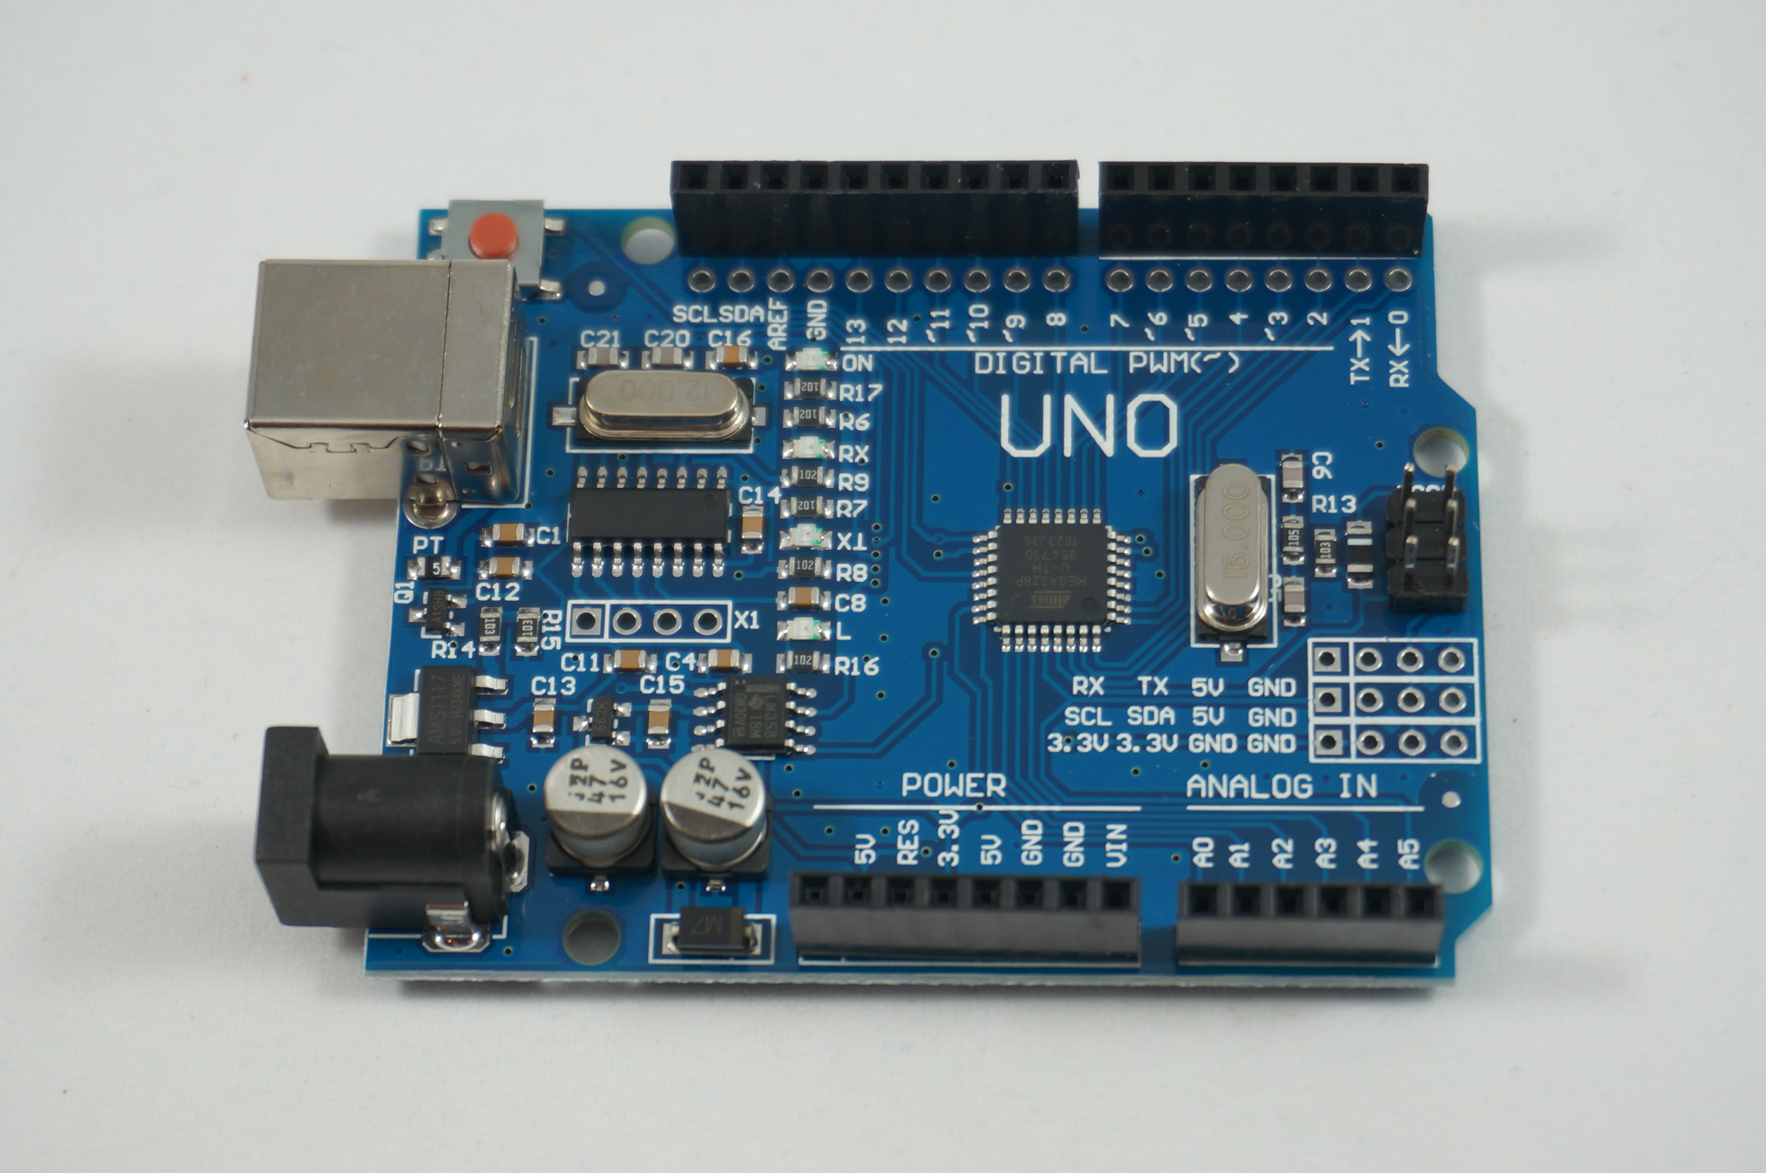
Microcontroller
 | CC3200 | ATMega 328P
Cost | $0 (Provided by TI Lab) | $1.96
Clock speed | 1MHz-80MHz | 16Mhz
GPIO pins | 27 | 54
Operating voltage | 2.1V - 3.6V | 5V
Communication | Wifi | With external module
Temperature sensor | yes | With external module
ATMEGA328P from Arduino Uno
Easy to use
Cheap
Various Applications ranging in size
Notes:
Miguel @
For the Microcontroller we decided to go with the Arduino Mega 328P. The reasons being, is the multiple GPIO pins, cheap,

Slide 14
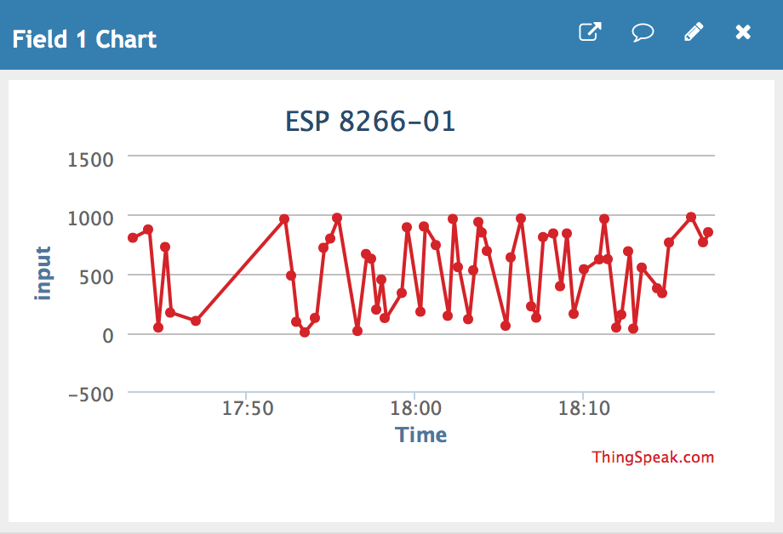
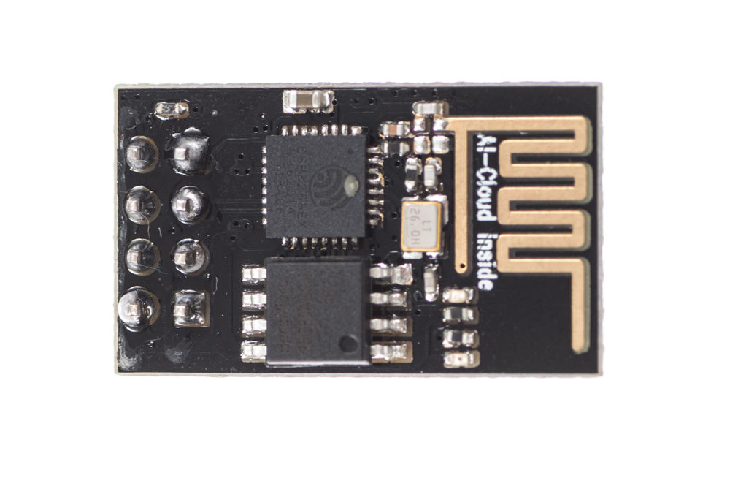
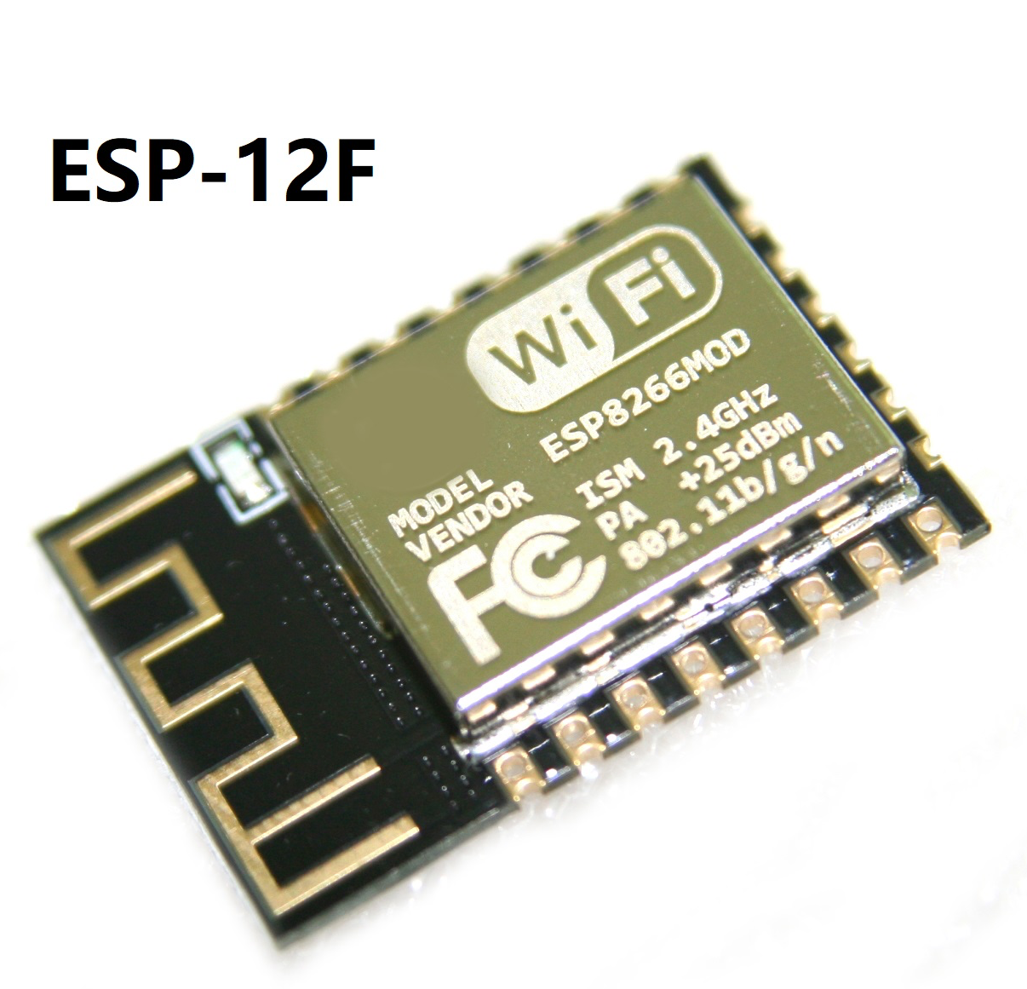
Wifi Module
ESP8266 ESP-01
Used for breadboard testing
Sent scale data to Thingspeak
ESP8266 ESP-12F
The antenna RF performance optimization
Similar footprint
Communication distance is increased by 30% -50%
Notes:
Miguel
l

Slide 15
Touch Screen: Xiamen Touch Foil
Vendor/Product name | Xiamen Touch [16] | Green Touch [15] | Gerteise [44] | Pro Display [45]
Touch Points | 10 | 10 | 10 | N/A
Response time | 10ms | <10ms | <2.5ms | 18-50ms
Driver Software | Linux, Mac | Linux, Mac | Windows, Linux | Windows, Linux
Light transmittance | >93% | >90% | N/A | >93%
Aspect Ratio | 16:9 | 16:9 | 16:9 | 16:9
Diagonal Size | 32-47” | 5”-60” | 27-55” | 17”-100”
Time for shipping | 7 days | N/A | 1- 2 months | N/A
Cost | $115 | $105 | $174.50 | $1,241
Important factors: estimated time for manufacturing, cost, response time, number of touch points, quality reviews, driver software
Capacitive touch foils varied very widely in cost.
Most US vendors cost upwards of $2000
alibaba.com was used to purchase directly from the manufacturer at a much more affordable price
Notes:
Gera

Slide 16
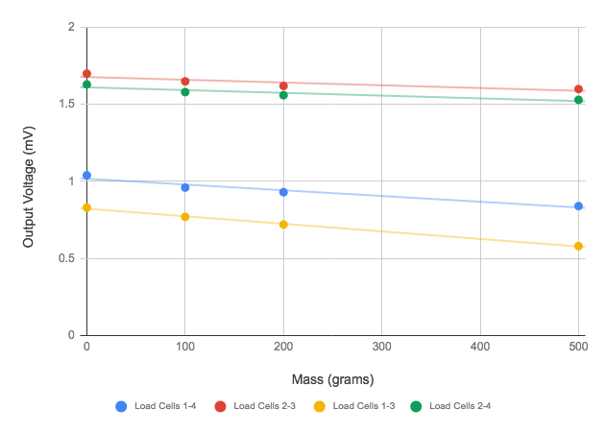
Load Cells
Vendor/ Manufacturer | Omega [48] | Manyyear (alibaba) [49] | Bigaint Digital Kitchen Scale
Load Range | 0-25lb | 0-5kg | 0-5kg
Output Voltage | 1mV/V | unknown | unknown
Excitation Voltage | 5 V (DC) | 5 V (DC) | unknown
Bridge Resistance | ≥350Ω | 1000Ω | ~500Ω
Thermal Sensitivity | Low | 2% over operating temperature range | unknown
Type | Compression | Compression | Compression
Documentation | Available | Available | Not available
Bridge type | Full | Full | Half
Accuracy | 0.5% | 0.05% | unknown
Size | ¾” | 37x47 mm | ¾”
Cost | $350.00 | $150 (minimum order of 10 and shipping) | $0 (already owned)
We choose to use load cells scavenged from previously owned kitchen scales due to budgetary constraints. All device specifications needed to be measured.
Load Cell Pair Output Voltage vs Applied Mass
Notes:
Gera

Slide 17
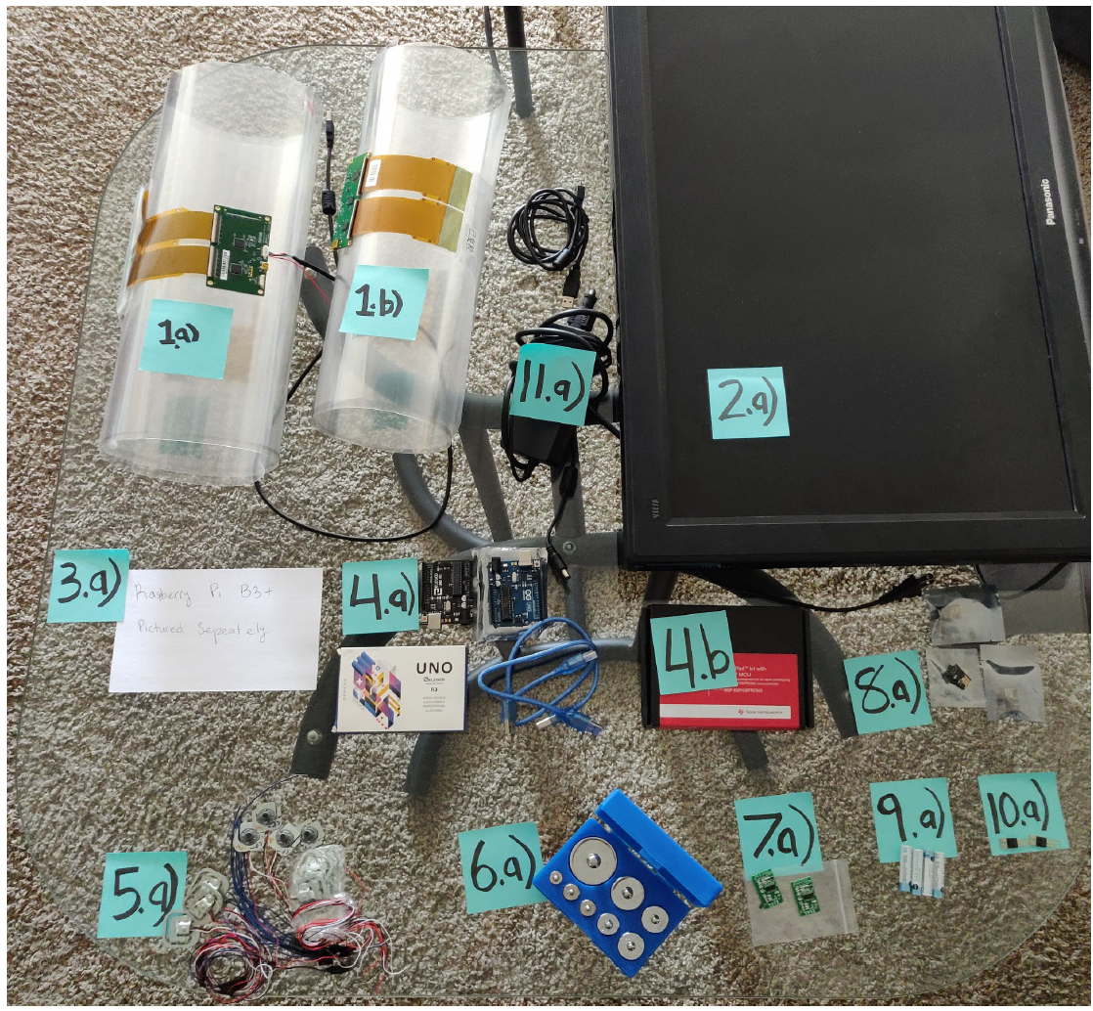
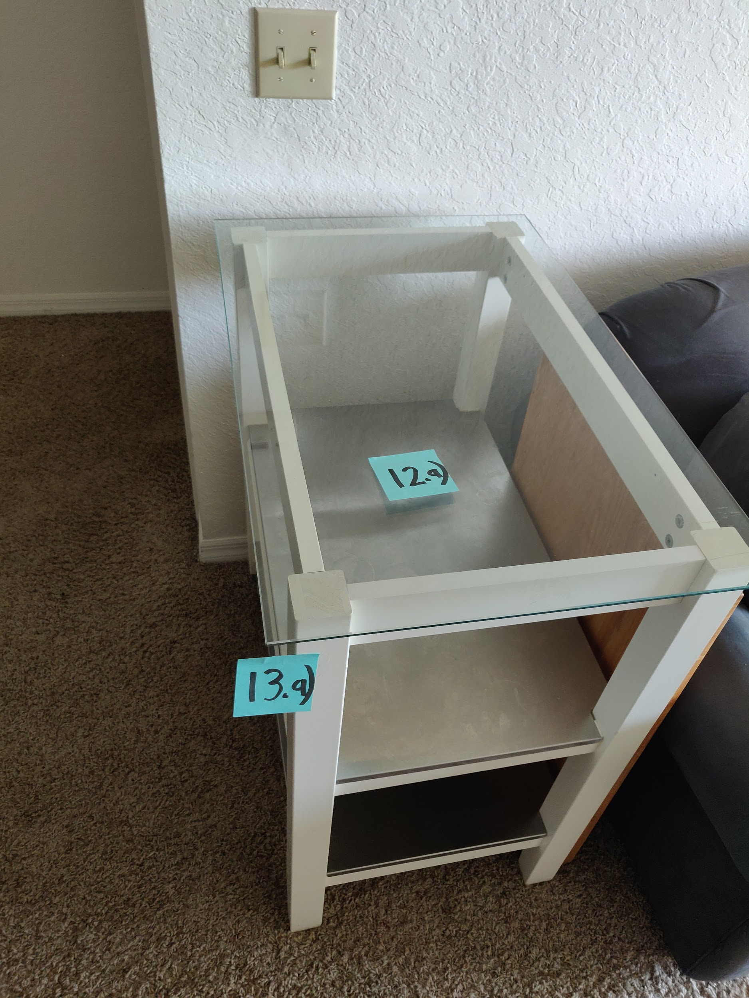
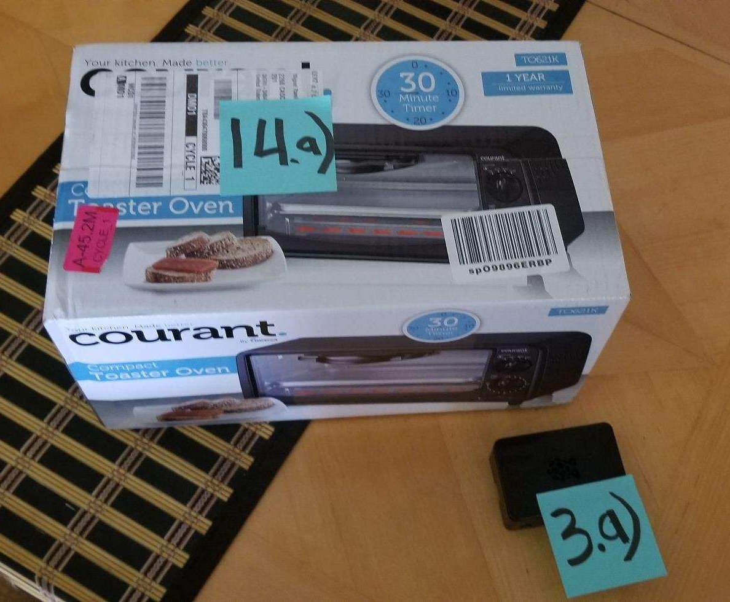
Part Selection for prototype
Notes:
Edwin
Here we demonstrate all the parts that, put together, form what will be our first prototype. We have the touch foil, the TV, the raspberry PI, the glass and the kitchen cart, which will form our smart tabletop. We also have the microcontroller, load cells, A/D converter, wifi module and some of the components which will form the wireless scale and PCB.

Slide 18
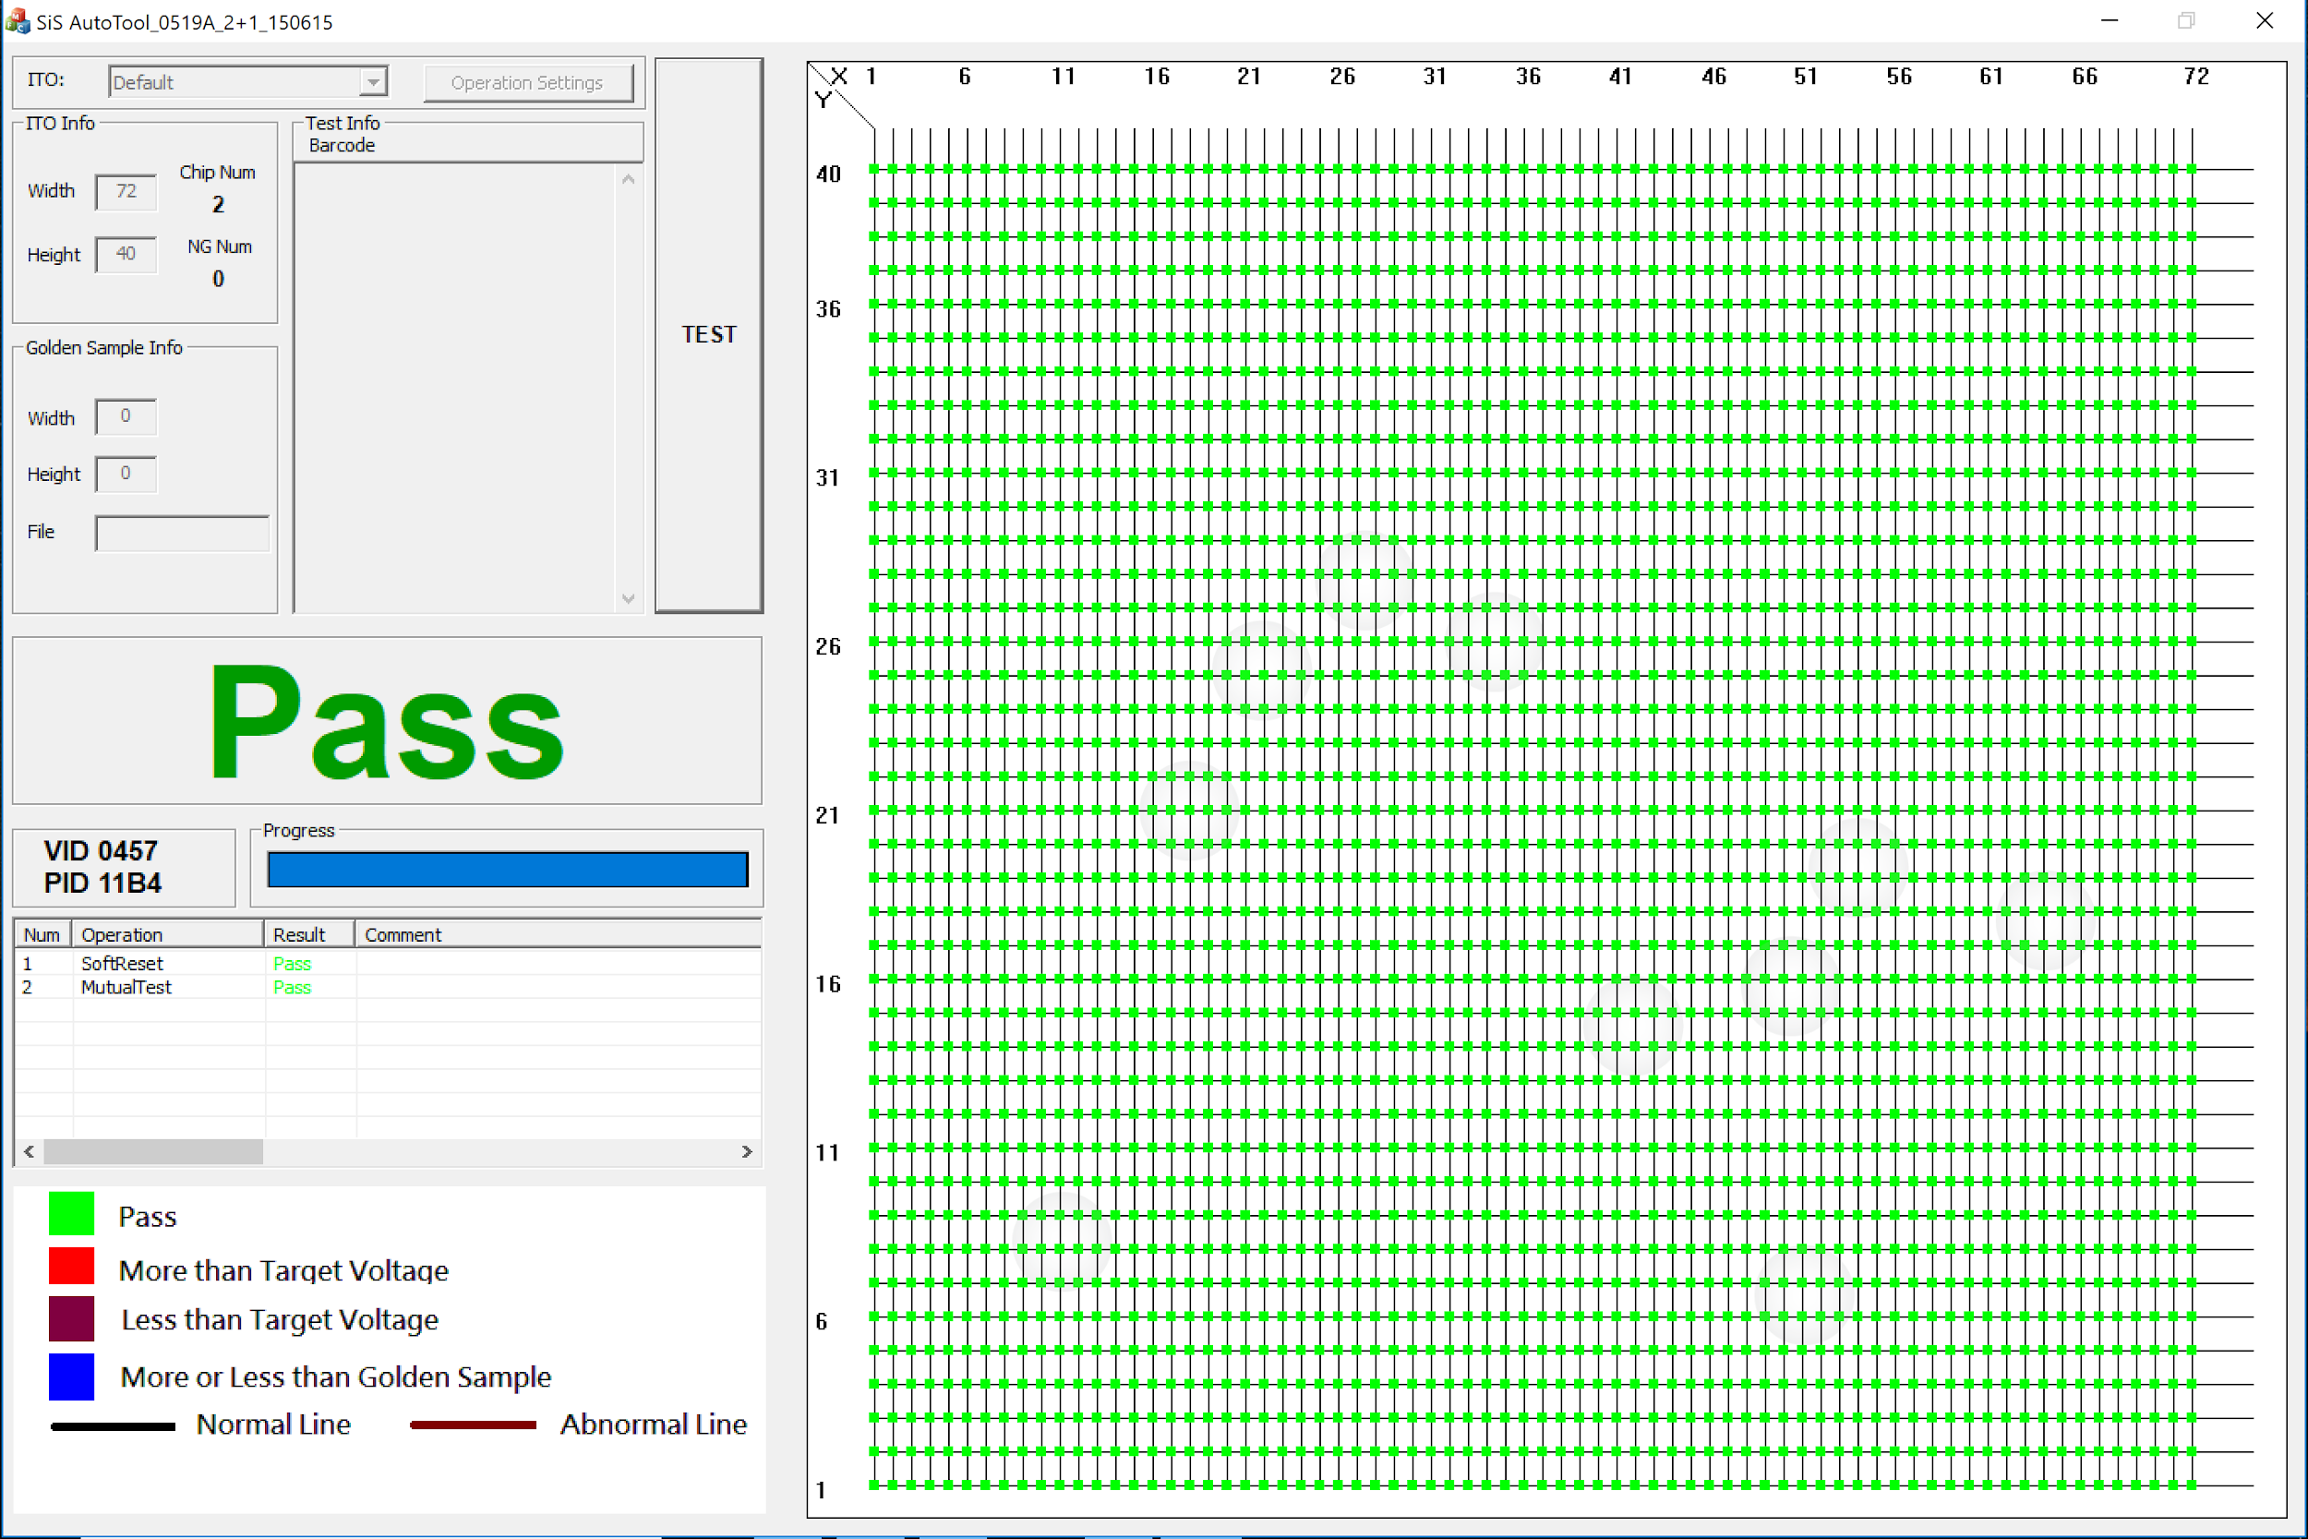
Subsystem 1: Single Board Computer and Touchscreen
Technology | Capacitive Touch foil [15],[16] | Rear Diffused Illumination (RDI) | Frustrated Total Internal Reflection (FTIR)
Response time | Fast | Medium | Medium
Multitouch | Touch points add to cost | Depends on software | Depends on software
Light transmittance | High | 100% | 100%
Sensitivity to objects | Low | High | High
Sensitivity to noise | Moderate (magnetic, electrical) | High (natural light) | Moderate (natural light)
Installation size | Small | Large | Large
Suitability for kitchen application | High | Moderate | Unsuitable (exposed LEDs and electronics on counter surface)
Software | Provided by manufacturer | Open source (OpenCV, CCV2) | Open source (OpenCV)
Cost | Large range ($100-$2000) | Moderate (~$100) | Moderate (~$100)
Issues with other technologies
Ghosting
Bulky Projectors
Expensive parts
Notes:
Miguel: The Raspberry Pi and the Touch foil were 1st tested by using a glass coffee table to hold the touch foil, while the glass surface layer rested on top of the touch foil. The touch foil was first tested using a surface pro, we ran the software to test the touch foil to make sure the setup was working. Whenever we touched the glass, input was shown on the surface pro. We then connected the touch foil to the raspberry pi. We were able to control the raspberry pi using just the surface glass.
Successes: Each part worked individually and connected (Pass touch screen)
Challenges: Dealing with noise on the touch foil from the display, tv noise

Slide 19
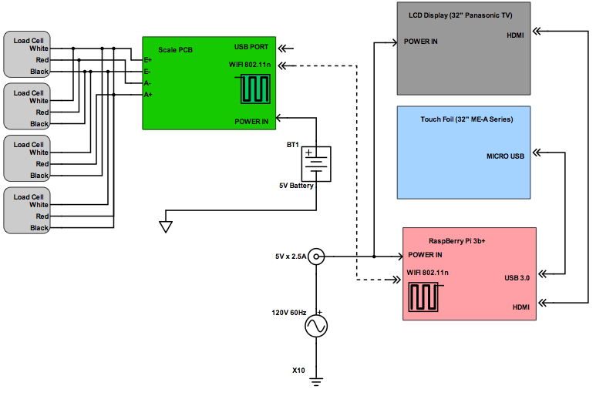
Subsystem 2: Wireless Scale
Successes:
breadboard testing went well, load cells and A/D seem to be operating linearly and accurately
breadboard testing of wifi module also successful
Challenges:
PCB
housing for scale
Part No. | Part Name | Quantity | Cost
1 | AtMega 328p | 1 | $2.08
2 | HX711 A/D | 1 | $2.40
3 | Load Cells | 4 | $0
4 | Wifi Module | 1 | $2.79
Total |  |  | $7.27
Notes:
Gera

Slide 20


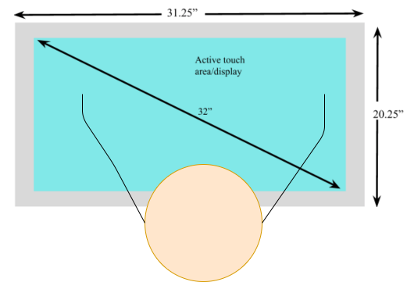
Software Design: Approach
Front-end: HTML5, CSS3, Javascript, Materialize
Back-end: Django
Design UI for a counter-top
Similar to tablets/phones but on a bigger scale
Notes:
Jason
Due to the fact that our application is very data driven, we decided that the best approach would be to create a website. The design of our website will provide a database for storage and retrieval, an API for all functionality, and an easy to design front-end for the user to interact with.
Miguel
Functioning counter - space for bowls and other items

Slide 21
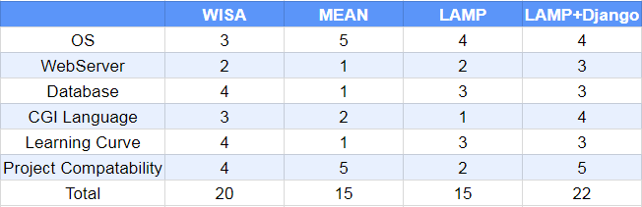
Software Design: Stack Choice
Notes:
Jason
The first design choice that needs to be made when creating a website is the software stack. As you can see in our decision matrix, the LAMP stack along with the Django framework ended up being our best option. LAMP stands for Linux, Apache, MySQL, and in this case Python. We decided to add the Django framework as it greatly reduces the development time of our website.

Slide 22
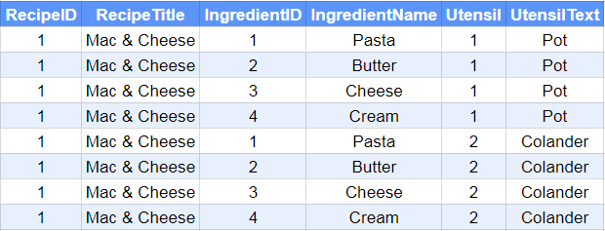
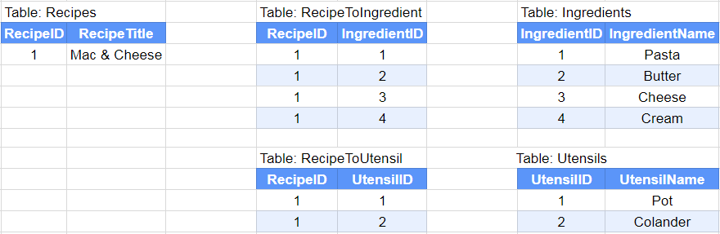
Database Optimizations
Optimize for memory
Naive approach is multiplicative in memory O(#recipes*#ingredients*...)
Optimized approach is linear in memory: O(#recipes+#ingredients+...)
Notes:
Jason
Another major design choice is our optimizations. Since our target environment is a single board computer, we decided to optimize for memory when creating our database. As you can see in the example tables, a recipe with a list of ingredients and utensils can be represented in two ways. The naive approach duplicates a lot of data and the number of rows is multiplicative. In order to optimize for memory, we create lookup tables to be allow us to implement lists in very little memory. Finally, since all of the ingredients across all recipes are stored in a single table, we never have to create more than one row of any ingredient.

Slide 23
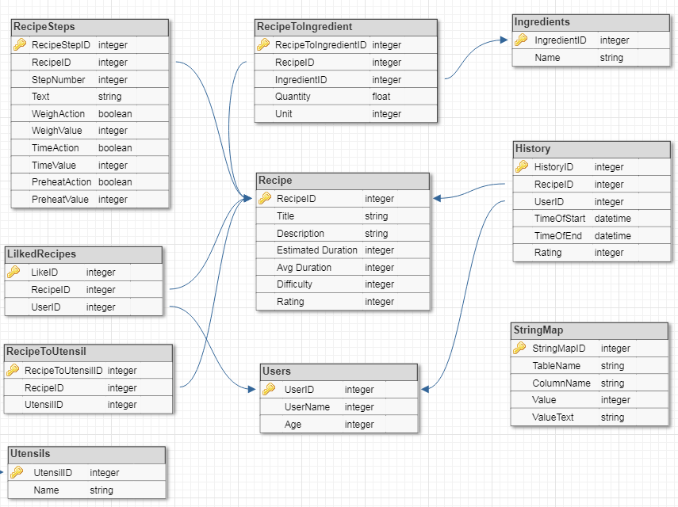
Database Design
Notes:
Jason
As you can see, our database design is very concise.
In the middle we have the recipe table, which stores the high level information of a recipe. Then at the top we have the recipe steps for execution, the lookup table for ingredients and the ingredient table. At the bottom we have the users table, where a user can have a list of favorite recipes. Finally, we have the History table which can aggregated in two ways. Either we can collect the history of a specific user, or the history of a specific recipe. Due to Django’s ease of use, we are planning on expanding our design and adding keywords to recipes as well as potential ingredient replacements so if the user is out of an ingredient the app can suggest a substitute.

Slide 24
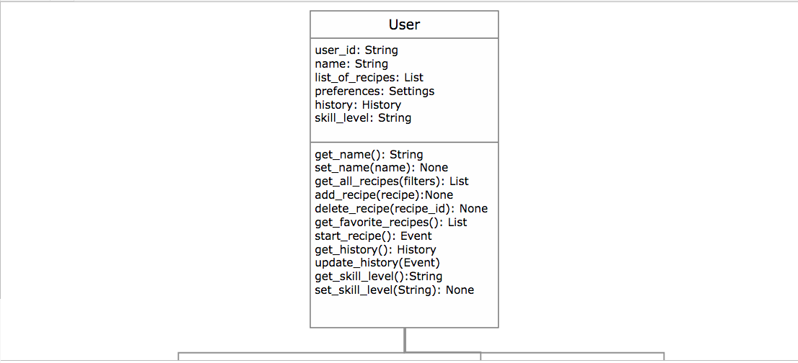
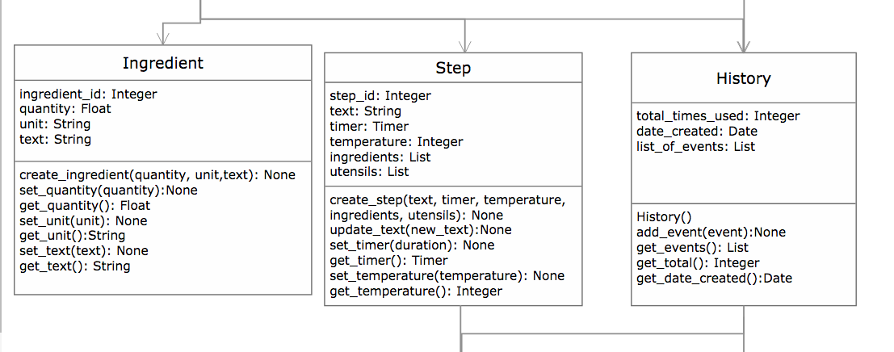
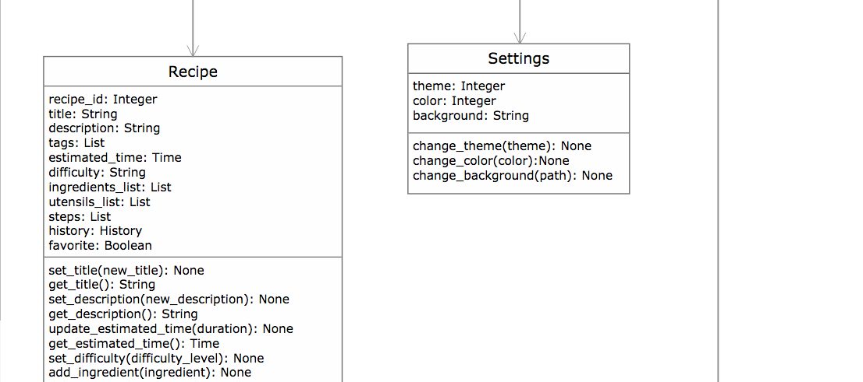
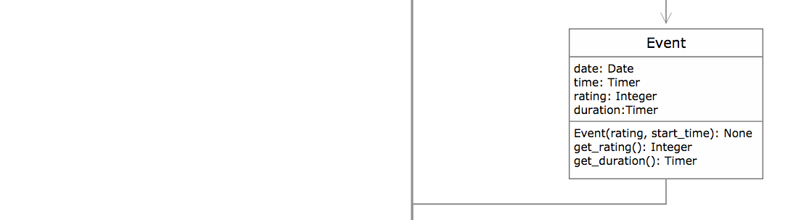

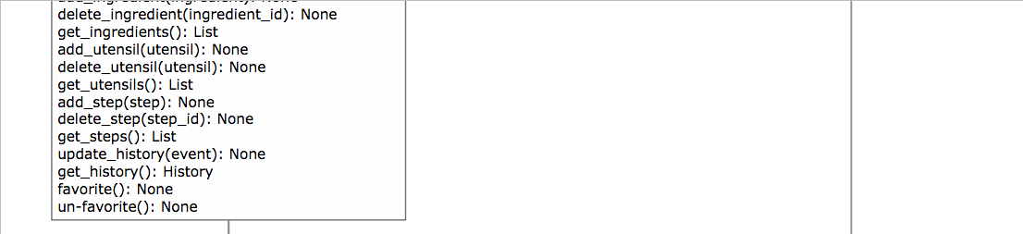
Software Design: Class Diagram
Notes:
Jason API functionality Gera and Jason?
Functionality - For the functionality of the API, we ensured that all of the data tables have the ability to retrieve and update. We also have the ability to send commands to execute recipes and send commands to the scale.

Slide 25
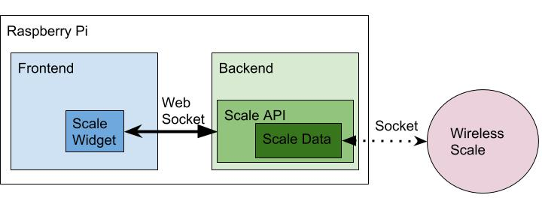
Software Design: Wireless Interface to Scale
WiFi enabled scale
Communicates with the Raspberry Pi via a socket
Django Channels on top of Django
WebSocket used to send data to the frontend
Notes:
Jason
In order for our scale to interact with our application, we will use several layers of communication. The first layer is the WiFi enabled scale communicating with our Raspberry Pi via a socket. Since the scale does not have it’s own display, the only way for us to show them the weight of the scale, we have to display it on the front-end. Therefore, this is an important case for optimizing for speed. Typically, in web servers you can’t have communication prompted from the back-end, it has to be prompted from the client side. So the original solution we had was to write the current scale value to the database, or a file, and then have the client continuously prompt for the current value. We feared that this wouldn’t be fast enough due to several layers of overhead. In order to solve this issue we will be using Django Channels, which takes Django and adds an asynchronous layer on top of it. Django Channels allows us to have functions in the back end persist to communicate with the scale. Finally, Django channels will enable us to use WebSockets where we will be able to forward the stream of data from the scale to the front-end.

Slide 26
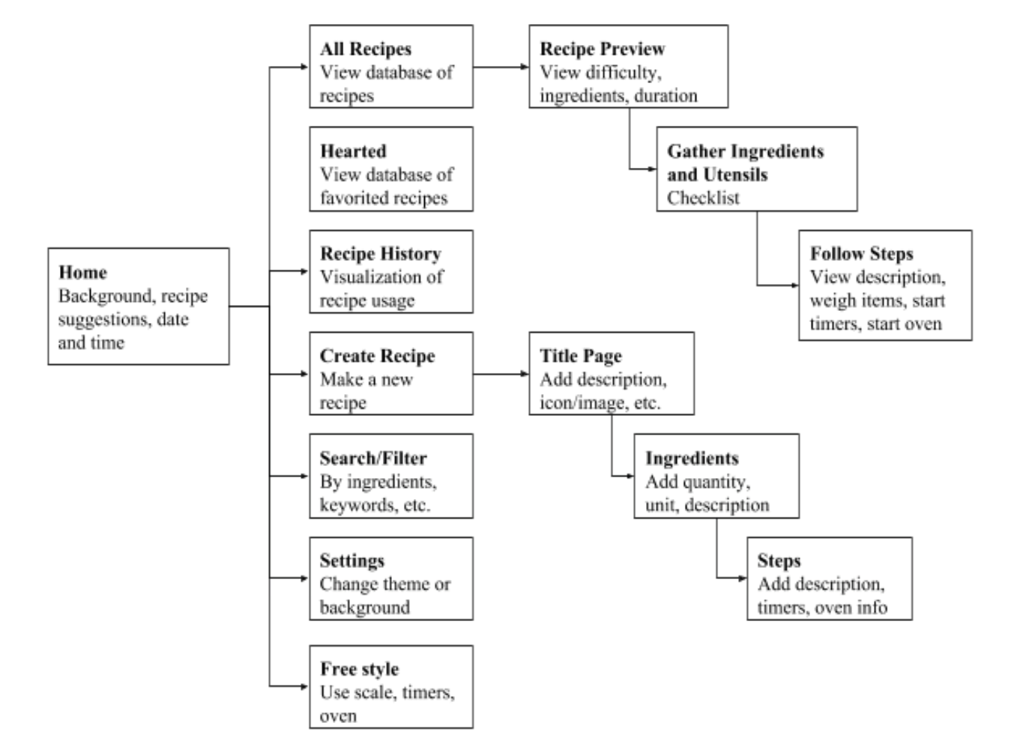

Software Design: UX
Notes:
Miguel On the right you can see the flow of how a user will interact with our application. As soon as they log in, they are shown recipe suggestions, recent recipes,
Add progress

Slide 27
Hardware Design
Two subsystems: the wireless scale and display/ touch-foil/ single board computer.
Wireless Scale: custom designed and printed PCB connected to four load cells and powered by a 5V battery.
Scale PCB: A/D converter, MCU, and wifi module as well as voltage regulation
The second subsystem: LCD display, touch-foil, and single-board computer.
This subsystem will be powered from AC mains via a wall wart.
Touch foil will be powered by and transmit data via a USB connection to the raspberry pi.
Notes:
Gera
5v to 9v

Slide 28
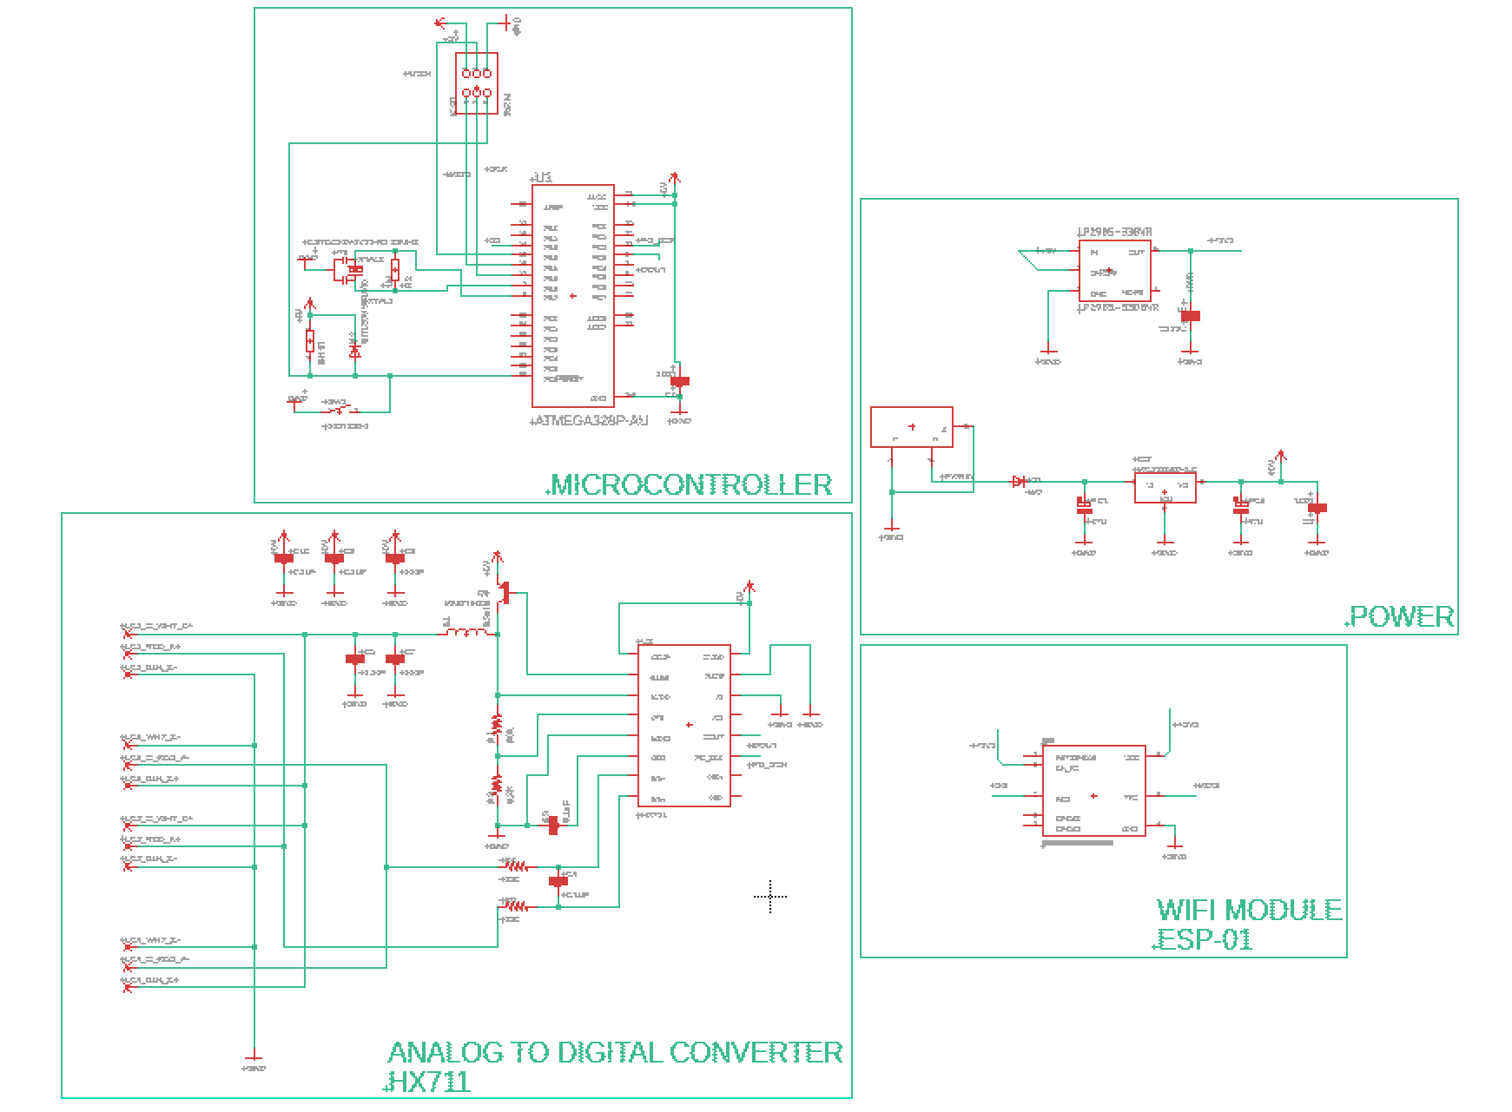
Schematic
Notes:
Edwin
Here is our schematic for the wireless scale, which will send real time data and interface with our assistant cooktop. It is categorized in 4 parts, microcontroller, power, Analog to digital converter and the Wifi Module.

Slide 29
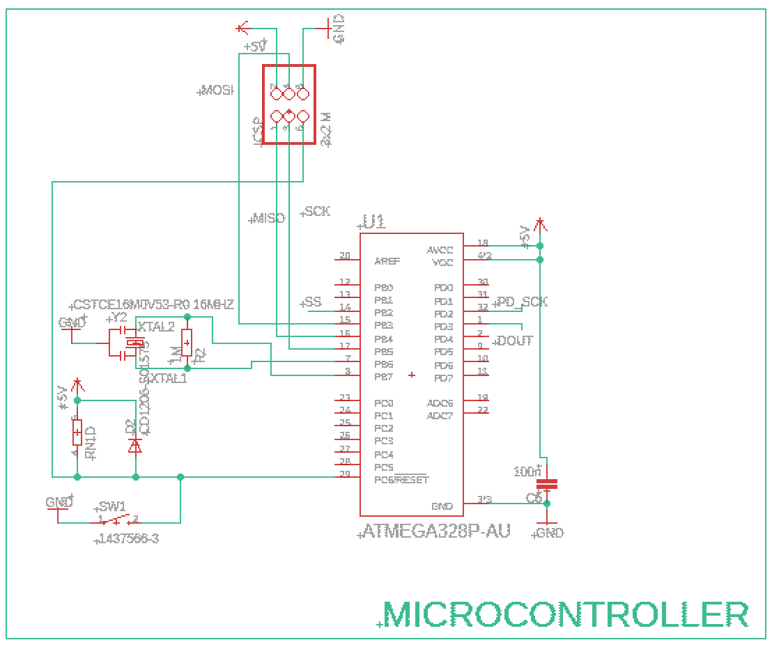
Microprocessor
ICSP to program microprocessor
16 MHz clock
Reset Button is active low
Notes:
Edwin
ICSP has all the communication, all te pins necessary to flash the code, has reset, Miso is needed for communication
The Microprocessor we used is the ATMEGA328P-AU, for its smaller footprint compared to its through hole counterpart. We have it connected to ICSP header pins so it may be programmed for our use. We have a 16MHz resonator, which will be placed close to the microprocessor to avoid any disturbance in the clock signal. Finally we have a reset button and we notice that it is active low, so its important to feed it some voltage that is not ground and when reset button is pushed, feed GND which will be inverted within the logic of the component and reset.

Slide 30
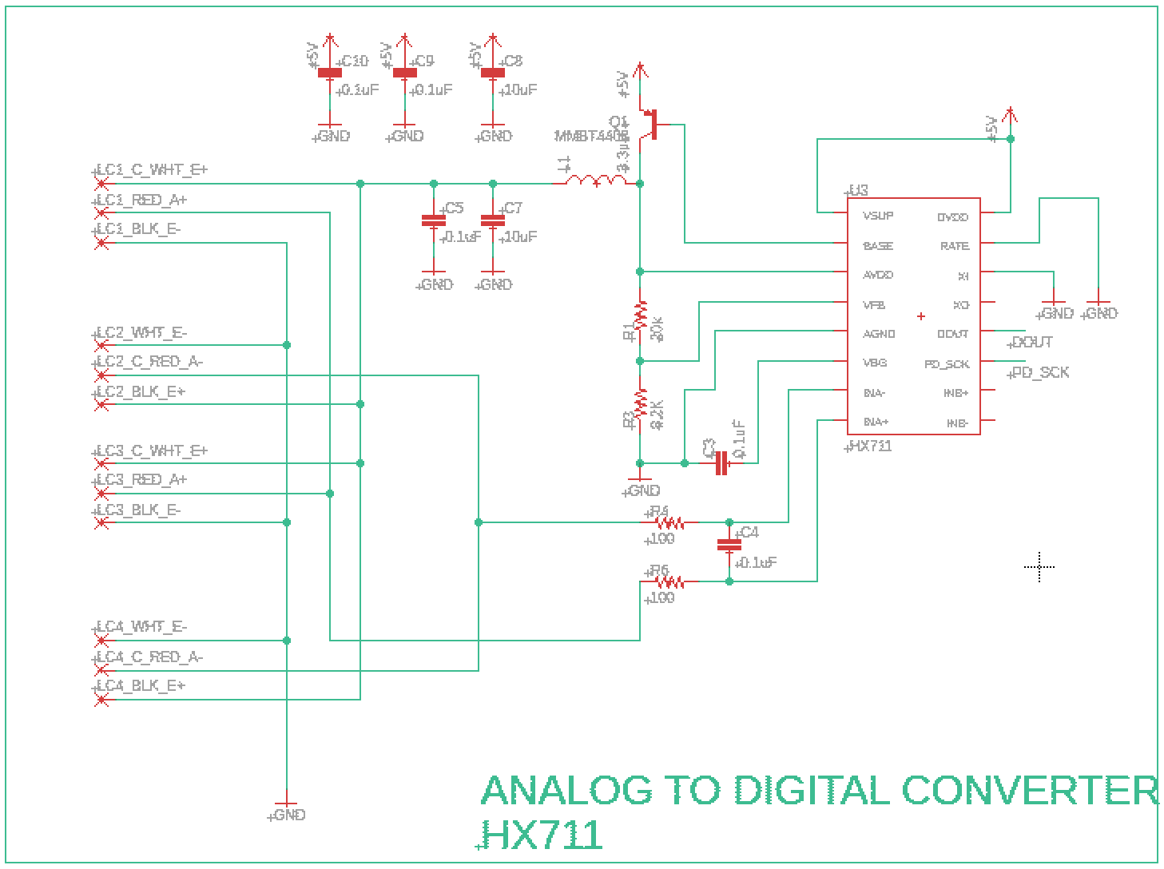
AD Converter
4 half bridge load cells will solder to wirepads on board for more reliable connection
Measures voltage from load cells and sends it to microcontroller to measure weight
HX711 provides serial interface for data retrieval via two control pins:
Clock line
Data line
Notes:
Gera

Slide 31
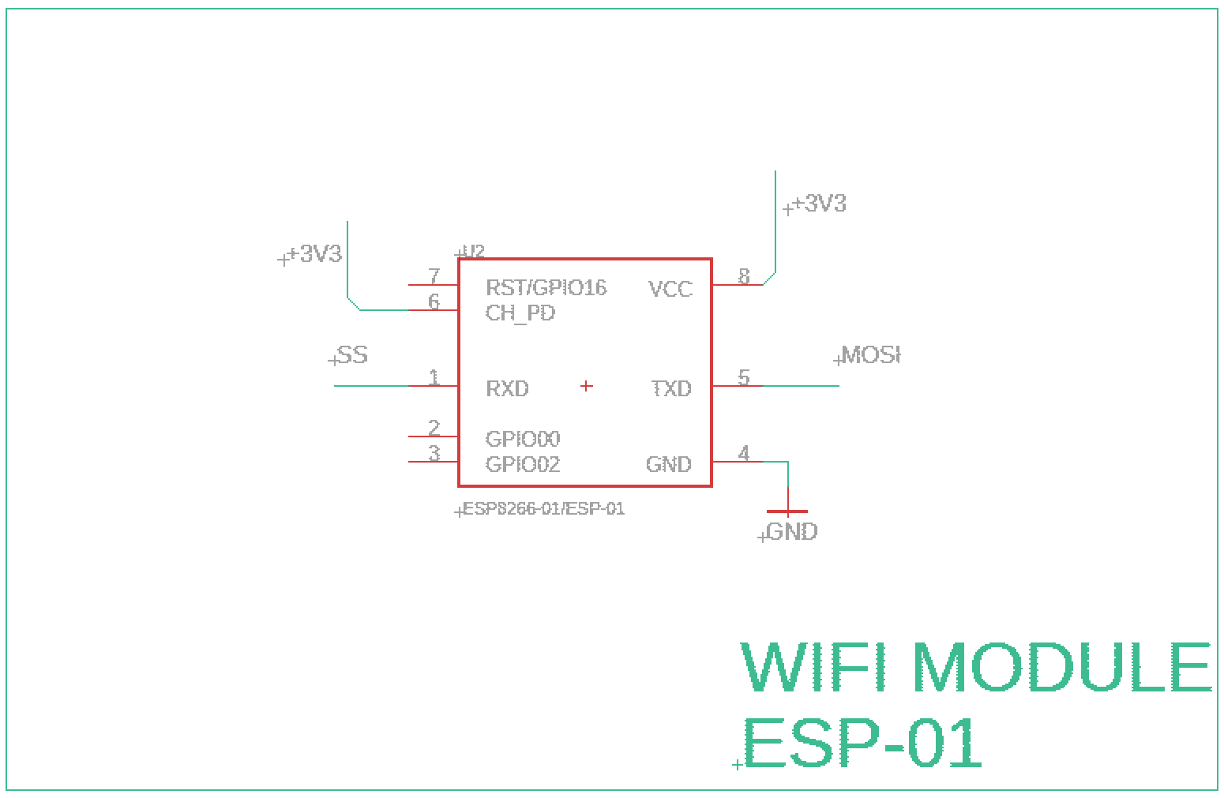
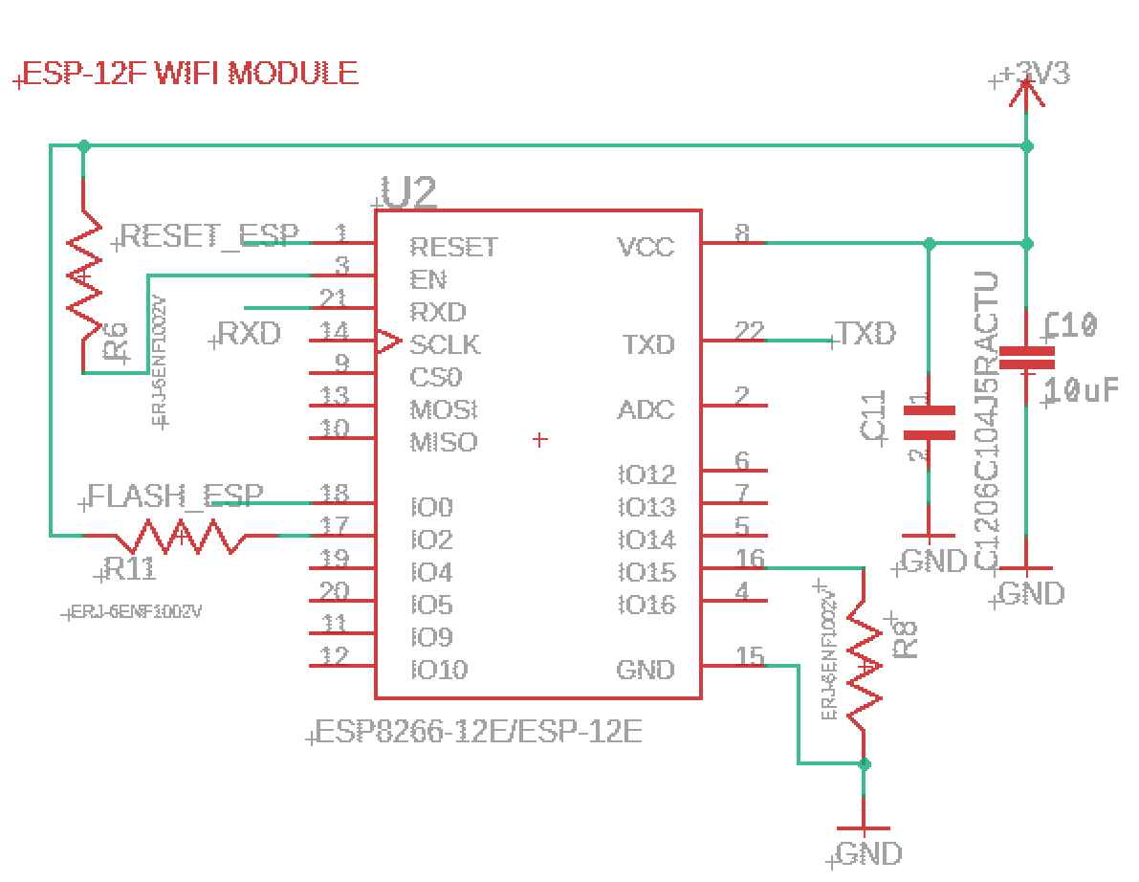
Wireless Connection
ESP8266 ESP-01 Wifi Module for 1st pcb
ESP8266 ESP-12f Wifi Module for future pcbs
Powered by 3.3V
Notes:
Miguel: Here is the schematic for the wifi modules. The esp-01 was used for very 1st pcb which was ordered last week. But upon more research, we found the esp 12F to be easier to implement into our PCB, as well as having better wifi features.

Slide 32
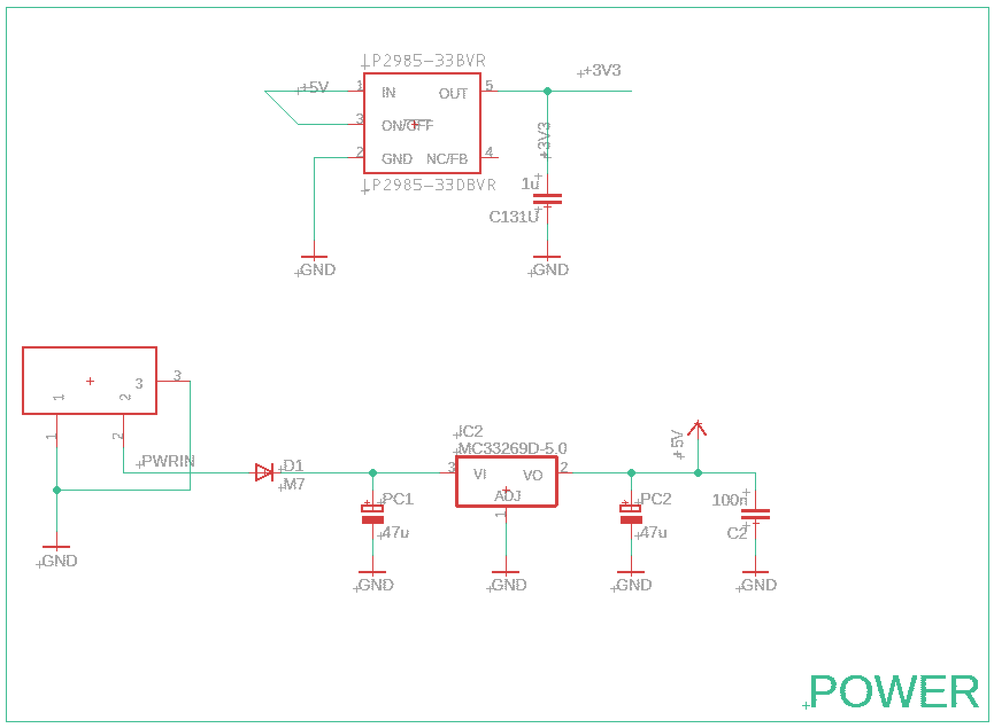
Power
Power to be received from 4 AA or 1 9V batteries through barrel jack
5V regulator to power microcontroller and HX711 (ADC)
3.3V regulator to power Wifi Module
Coupling Capacitors are placed in the design to prevent interference
Notes:
Edwin
In this power segment of our schematic, power will be received by 4 AA batteries or a single 9V battery through a barrel jack. The 5V regulator will feed power to the microcontroller and the HX711 since they both operate at 5V. In near proximity to the 5V regulator, capacitors are placed in order to provide a cleaner signal. Finally we have 5V being fed to the 3.3V regulator, which will be used to power the Wifi Module. Also in near proximity we have a coupling capacitor to provide a clean signal to our component.
Power supply considerations for the wireless scale include a 9V battery or 4 AA batteries. To decide between these two methods, we need to see how much real estate they both take up and choose the one that takes up less. The less space it takes up, the smaller the PCB enclosure, which is important to us in order to make the design look slim and neat and not bulky.

Slide 33
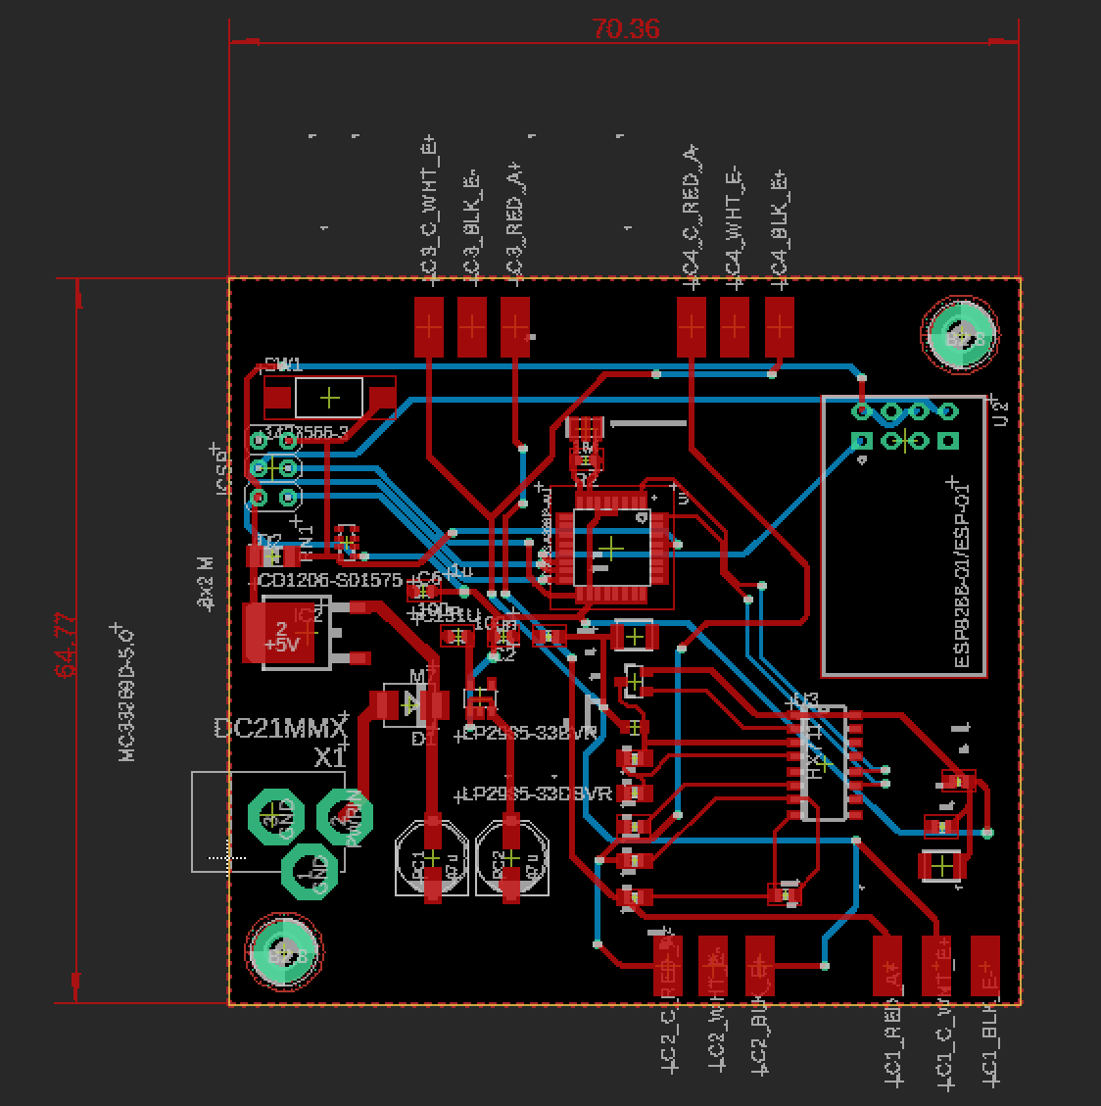
PCB
Created in Eagle
64.77mmx70.36mm
Microcontroller is centered in board design
Surface mount wire pads for four 3 wire load cells
Two (2) mounting holes to secure design in place
Notes:
Edwin
This is our prototype PCB. Its about 3 inches both ways and is designed with the microcontroller centered on the board, has the wifi module on the top right, the ADC (HX711) on the bottom right, the barrel jack on the bottom left and has 12 wire pads in order to solder 4 load cells that have 3 wires each. We placed mounting holes on just two extremes in order to secure board to PCB enclosure within the scale. In this board we aimed to understand how elements printed out such as the mounting holes and the wire pads. After these are understood and all main functions prove successful, we will do another revision to finalize the design.

Slide 34
PCB Concerns
First PCB ordered, awaiting arrival
Haven’t tested first board
There are two large power consuming devices on the board:
The Wifi Module, which draws 215mA max
The Microcontroller, which draws 360mA max
Total max current draw is 575mA at any one time through the 5V regulator
Notes:
Edwin
Concerns that come along with our PCB is that we haven’t tested its functionality yet. Hopefully it will work on our first attempt and complete another milestone for our project. Within our PCB we have two components that consume significant power. The Wifi Module draws about 215ma and the Microcontroller draws 40mA max per pin. Since we are using 9 of its pins, that puts its max current draw at 360mA. If we add both these currents, we have a total of 575mA at any one time through the 5V regulator. Therefore it is important that our regulator is well above this value.

Slide 35
Budget
Part | Unit Cost | Our Unit cost
Monitor | $109 | $0 (donated)
Kitchen Cart | $159 | $0 (donated)
Raspberry Pi 3 b+(kit) | $80.00 | $80.00
Load Cells | $7.99 | $7.99
Tempered Glass | $68.00 | $68.00
Touch foil | $120.00 | $120.00
Arduino ATMega 328p | $1.96 | $1.96
Hx711 A/D Converter | $5.00 | $5.00
PCB | $1.00 | $1.00
Wifi module | $4 | $4
Total | $551.95 | $283.95
Part | Cost
Raspberry pi 3 b+ | $80.00
Scale | $20.00
Toaster oven | $20.00
Sd card | $11.00
Tempered Glass | $68.00
Touch foil | $115.00 + Shipping
Kitchen Cart | $0 (already had)
32” Monitor | $0
Breadboard Testing Kit | $33.50
Arduino Mega 2560 | $20
TI ADS2132REF | $0 (TI provided)
HX711 A/D Converter | $24
A/D Converter and Load Units for Scale | $30
Total | $421.5
Budget of $2000
Notes:
Miguel
Add adjusted budget

Slide 36
Group Member Responsibilities
 | Jason | Gera | Miguel | Edwin
Hardware Design |  | Primary | Secondary | Secondary
Software Design | Primary | Secondary | Primary
Wireless Scale | Secondary | Primary | Primary | Secondary
PCB |  | Secondary | Secondary | Primary

Slide 37
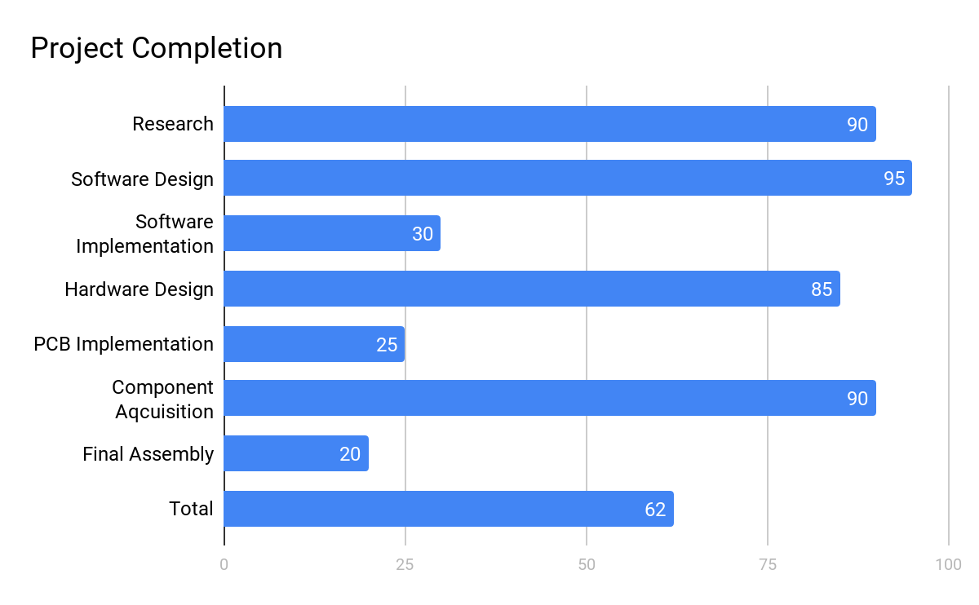
Project Progress
Notes:
Edwin
We are almost complete in the research and design aspects of our project and are focusing our efforts in the implementation stages and making good progress. As I stated earlier, once we get the PCB up and running, we will gain more momentum and strive for completion. Overall project progress is 62%

Slide 38
Current Challenges
PCB: hard to do breadboard testing with individual components because many are only available as SMD
Wifi Communications
Noise in touch foil
TV doesn’t fit
Notes:
1.GERA
2. As you saw in the previous slides, the scale integration is quite complicated and have several layers of communication and since we have not implemented it we do not know the speed that the values will be able to update on the screen.
3.Miguel Another issue we currently have, is that the tv monitor is causing noise in the touch foil. So we need to figure out the distance to properly space the monitor from the touch foil, while still being contained in our
4.Edwin
The television that I personally donated to our project is too bulky for the table chosen. We are at a crossroads where we either get a slimmer TV from Walmart or widen the kitchen carts dimensions.

Slide 39
Plan for Project Completion
PCB final design and testing
Code for app and scale
Frame for TV
Enclosure for scale
Notes:
Edwin
In order to complete our project, we need to address what needs to be done. Most of our items on this list revolve around finishing the PCB. We must test all of the PCBs functions and then move towards finalizing the design, then communicate with the software team and develop code that will communicate with the scale while also developing the code for the RecipeTop as well. Parallel to developing the code, the hardware team needs to design an enclosure that will house the scale, the load cells and the battery. Scale aside, we also need to develop a frame for the TV so that our tabletop can look sleek and also house the raspberry Pi.

Slide 40
Questions?

Slide 41
References
https://www.electroluxgroup.com/en/3-trends-from-smart-kitchen-summit-that-will-reinvent-the-cooking-journey-25743/
https://infographicjournal.com/the-smart-kitchen-of-the-future-is-here/

